Slide 1
LEAVES & UCPATH ENTRIES FOR
DE-CENTRALIZED CAMPUS
2026

Slide 2
TODAY'S PRESENTERS
Wendy Pawling
Disability Management Specialist
Trish Schnaithmann
Leaves Administration Manager

Slide 3
AGENDA
Sedgwick Information
Lincoln Financial
FMLA/CFRA/PDL/PFCB 101
Other types of Leaves – Bereavement, Personal, Reproductive Loss Leave
How to Manage Leaves including UCPath Entries
Impact to Benefits
Timecard Coding
Accommodations/Disability Management & The Interactive Process
Resources and More!

Slide 4
UCI Partners
Sedgwick
Lincoln Financial Group

Slide 5
SEDGWICK STAFF LEAVES SUPPORT
UCI partners with Sedgwick to administer Staff leaves and requests for reasonable accommodation for Campus, Health Sciences and all Health employees. Leave types include:
Family and Medical Leave (FMLA)
California Family Rights Act (CFRA)
Medical
Pregnancy
Parental Bonding
Care for a Family Member
Military
Please Note: Faculty/academics, postdocs and residents (AFT, M9, UAW, and UAPD will continue to be managed internally.

Slide 6

HOW TO INITIATE REQUEST WITH SEDGWICK
mysedgwick Portal:
  https://hr.uci.edu/sedgwick
  login with UCInetID and password
Toll Free: (855) 922-2152
  Interactive Voice Response 24/7/365
  Service Center 5am to 5pm M-F
  Leave Specialists 6am to 7pm M-F
Opting into communications via text and email messaging is recommended
Some information to have available when initiating a request include:
  Reason for Absence (i.e., own medical, family medical, pregnancy, parental bonding, etc.)
  Employee's Contact Information
  Anticipated begin and end dates (end dates are not always available and that's okay)

Slide 7
SEDGWICK CONTACT METHODS
Employee and Supervisor Contact
mysedgwick Portal: https://hr.uci.edu/sedgwick
  The Communication Center within mySedgwick allows you to communicate directly with the Sedgwick case specialist.
Phone (855) 922-2152
  Interactive Voice Response 24/7/365
Fax to: (855) 800-5116
  Include Employee Name and ID number or claim number.
Existing Claims Only
  Medical documents can be emailed to: Claimdocuments@sedgwick.com
  Include Employee Name and ID number or claim number.
Supervisor Use Only
Questions, Concerns, or to Check a Case Status, email Sedgwick at:
UCIrvine@sedgwick.com
*please do not share this email with our co-workers.
  Include Employee Name and ID number or claim number.

Slide 8
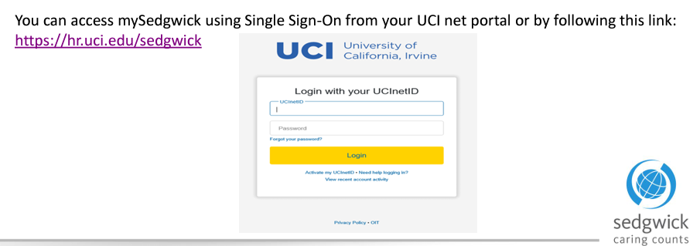
MYSEDGWICK hr.uci.edu/Sedgwick
Search for your employee’s leave of absences.
Review Leaves Status’s
Submit New Leaves
Submit or Upload Medical Documentation
Communicate with the Sedgwick’s Case Examiner
Notes:
Share the mySedgwick Manager’s Guide

Slide 9
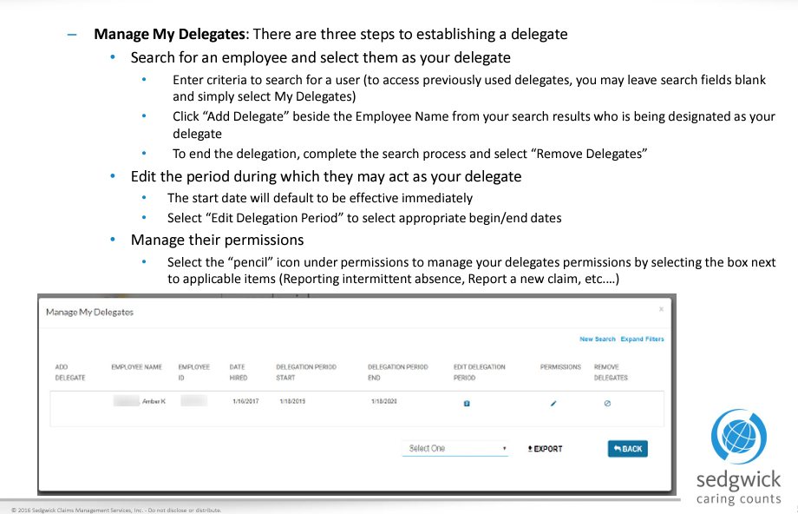
MYSEDGWICK CONTINUED

Slide 10
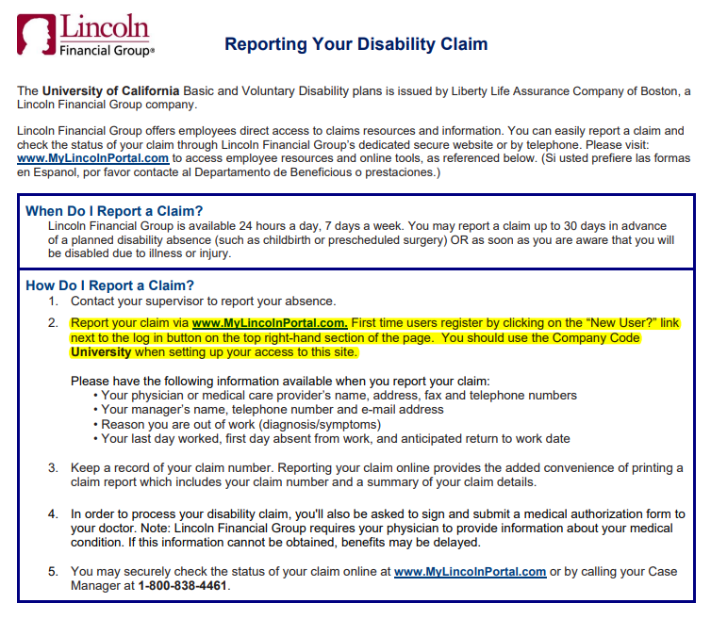
LINCOLN FINANCIAL GROUP

Slide 11
Leave of Absences
Entitlements

Slide 12
LEAVE TIMELINE
Employee provides medical documentation to Sedgwick
Employee misses more than 3 consecutive days, we recommend for the employee to initiate a leave
Employee and Supervisor are notified of the decision via Sedgwick communication.
Employee expresses the need for more time off and submits medical documentation to Sedgwick.
Employee may provide Sedgwick with release to return to work
Initiate Leave
Documentation Review
Decision
Extension
Return to Work
Dept refers Employee(EE) to Sedgwick, EE initiates leave. Dept meets with EE to discuss pay options during leave. Explain accrual usage if applicable per policy or bargaining agreement. Offer Catastrophic Pay Program (if applicable). Provide EE with Lincoln Financial Group info (if leave is for EE’s own serious health condition).
Sedgwick determines if medical substantiates the leave, once determination is made, the appropriate notices are sent to Supervisor and employee.
Dept will check Sedgwick portal for approval of leaves. Dept will enter leave into UCPath with accurate leave type, entitlements, and pay status. Dept will provide the EE with an outline of their leave and what is expected for them to enter in TRS or API during their leave. Dept will track and update the leave throughout the leave cycle.
Employee will partner with the department to discuss continued pay options and department will enter extended absence in Path.
Supervisors can reach out to the employee to discuss return to work plans/scheduling. Sedgwick also reaches out to Supervisor to confirm return to work, once confirmed Dept will return the employee in Path.

Slide 13
NEW LEAVE CHECKLIST
Review UCPath, under Administer Extended Absence for any leaves that would affect current leave.
Review Leave case in Sedgwick (MySedgwick) for status and eligibility.
Review EE’s information under Job Data.
  What is their FTE?
    Job Information Tab
  Are they exempt or non-exempt?
    Payroll Tab.
Review their accrual balance under Review Absence Balance in Path.
Which Union are they with, this depends on which accruals they can use depending on leave type, refer to the spreadsheet (Leave Chart by Bargaining Unit).
  Union information can be found under Job Data, under Job Labor.
If leave for own medical - Review UCPath Benefit Summary to see which STD plan they have.
  Basic: up to maximum of $800 a month.
  Voluntary Short-Term Disability, 60% of base salary.
  14 days waiting for both, must use up to 176 hours/22 days sick, if FTE is 1.0 (40 hours a week).
Email EE to schedule consult.
Complete consult, set appropriate follow up reminder, ie: Confirm FDA (first date of absence), Enter EA (extended absence) in Path before Path deadlines, refer to guide for these dates, check Sedgwick status, Confirm delivery (if applicable), and confirm RTW.
  These examples are not all inclusive.
Send employee time coding outline. Review and ensure timecard is updated appropriately.
Notes:
Unsure where to position this one.

Slide 14
FAMILY MEDICAL LEAVE ACT (FMLA)
Provides up to 12 weeks unpaid leave per calendar year for:
Employees serious health condition (inc. pregnancy)
To care for a new child, whether for the birth of a son or daughter, or for the adoption or placement of a child in foster care.
To care for a seriously ill spouse, son, daughter, or parent. The child must be under age 18, or over age 18 with a qualifying mental or physical disability.
To recover from the worker’s own serious illness.
To care for an injured service member in the family.
Eligibility requirements: employed 12 months and have worked 1,250 hours during the 12 months prior to leave
Unpaid leave; provides job protection
Provides for continuation of UC employer paid contributions (medical, dental & vision)

Slide 15
CALIFORNIA FAMILY RIGHTS ACT(CFRA)
Eligibility requirements are the same as FMLA, 12 months of service and 1,250 hours worked.
Eligible employees may take CFRA leave for a child, spouse, domestic partner, parent, parent-in-law, grandparent, grandchild, sibling, or someone else related by blood or in a family-like relationship (“designated person”) with a serious health condition.
Provides up to 12 weeks of leave. Will begin after PDL ends.
Parental Bonding –to bond with new child.
  Must be taken within 12 months of birth/placement.
  Must be taken in at least two-week increments.
  May take leave of less than two-week duration on two occasions.
Unpaid leave; provides job protection.
Provides for continuation of UC employer paid contributions (medical, dental & vision)

Slide 16
PREGNANCY DISABILITY LEAVE (PDL)
Period of time when considered medically disabled due to pregnancy.
Generally, begins 2 weeks before birth and ends 6 weeks after birth (8 weeks for C-Section).
Up to 4 months (based on medical certification).
Unpaid leave; provides job protection.
Provides for continuation of UC employer paid contributions (medical, dental & vision).

Slide 17
PARENTAL BONDING
  California Family Rights Act (CFRA)
  Eligibility requirements are the same as FMLA
  Provides up to 12 weeks of leave
    Will begin after PDL ends
  Parental Bonding – to bond with new child
    Must be taken within 12 months of birth/placement (the leave must end the day before the 1st birthday)
    Must be taken in at least two-week increments
    May take leave of less than two-week duration on two occasions.
  Unpaid leave; provides job protection
  Provides for continuation of UC employer paid contributions (medical, dental & vision)

Slide 18
SUPPLEMENTAL FML
  A regular status non-represented employee who has exhausted all FMLA is eligible for Supplemental FML for up to an additional 12 workweeks or until the end of the calendar year, whichever is less, if the need for a FML that is in progress continues beyond 12 workweeks.
  However, the aggregate absence from work for PDL, other FMLA, and Supplemental FML may not exceed seven months during the calendar year, except as may be required by law.
  For employees on Supplemental FML, health plan coverage (medical, dental, and optical) will continue in accordance with each plan’s requirements. *Subject to full-premiums (UC Employer and Employee Costs) for benefits
  An employee may elect to substitute accrued vacation, sick leave, PTO (if applicable), and/or compensatory time off for leave without pay if the underlying FML is due to the employee’s own pregnancy disability or other serious health condition.
  An employee may elect to substitute accrued vacation and up to 30 days of sick leave in a calendar year if the underlying FML is to care for a family member with a serious health condition, parental bonding leave, or Military Caregiver Leave as provided for under applicable provisions of the policy.

Slide 19
REPRODUCTIVE LOSS LEAVE
NOT MANAGED BY SEDGWICK
Eligibility:
  Employed with UCI for at least 30 days. We do not require nor ask for supporting documentation. The employee has a choice on completing the form (Form located on the HR Leaves Page.)
Reproductive Loss Leave is defined as:
  Failed adoption, failed surrogacy, miscarriage, stillbirth, or an unsuccessful assisted reproduction.
Duration:
  An eligible employee may take up to five days consecutive or non-consecutive of Reproductive Loss Leave following a reproductive loss. If the employee experiences more than one reproductive loss, the employee may take up to a total of 20 days of Reproductive Loss Leave within a calendar year (no more than five days for each loss).
Processing Leave Requests:
  Due to the sensitivity around these leaves, Department Leaves Contact & UCI Leaves Team will be managing these leaves in collaborationn. Please do not refer them to Sedgwick, refer the employee to the EEC for the initiation process.
Pay:
  Reproductive Loss Leave is unpaid, but eligible employees may elect to use certain types of paid leave to remain on pay status during this leave depending on the policy or collective bargaining agreement that applies to the employee.

Slide 20
BEREAVEMENT LEAVES
NOT MANAGED BY SEDGWICK
Managed by the department Human Resources contact.
Unpaid Leave.
Check PPSM and Bargaining Agreements for leave accrual usage.
CLP (Catastrophic Leave Pay) can be requested for bereavement leaves.
Employees on unpaid status are subject to full benefit premiums
(Employer and Employee portions).

Slide 21
PERSONAL LEAVES
Managed by Sedgwick and department Human Resources contact.
Unpaid leave.
Check PPSM and Bargaining Agreements for permissible leave accrual usage.
Personal Leave decisions are at the discretion of the department to approve or deny the request. Please note you do not have to approve the entire requested duration, may approve a shorter duration that works best for the department. Be sure to be consistent with your practices.
Employees on unpaid status are subject to full benefit premiums (Employer and Employee portions).

Slide 22
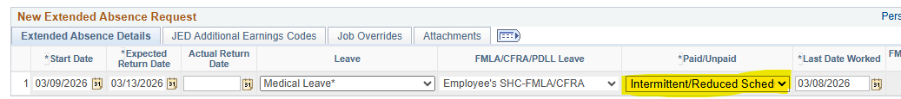
REDUCED WORK SCHEDULES
Exempt & Non-Exempt (if the employee chooses to supplement their reduced schedule with accruals): Dept must enter the reduced work schedule extended absence entry in Path and enter the hours missed for each day on their timecard and use applicable accruals.
Exempt (no accruals beyond waiting period and filing for Disability Benefits): Dept must enter the reduced work schedule extended absence entry in Path, then loop in the HRBP to temporarily lower the appointment/FTE % while maintaining the position at 100%.

Slide 23
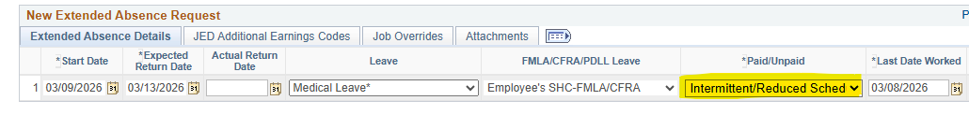
INTERMITTENT LEAVES
Employee must report all absences to Sedgwick and follow their department's call-in procedure.
Reporting requirement for Sedgwick is within 5 calendar days of the absence.
  If they do not report it to Sedgwick, then the absence is not being decrementing from their FMLA/CFRA balance.
Exempt employees can report accruals in less than 8-hour increments on their timecard if they have an approved intermittent leave. Path will kick the timecard back if there is not an extended absence entry in Path.

Slide 24
RETURN TO WORK
As a manager or Department Leave Administrator, you are welcome and encouraged to check in periodically and discuss return to work plans with the employee.
For an employee’s own medical condition, a medical release note is not required for an employee to return to work. However, if they have a note, please be sure the employee submits the note to Sedgwick.
Upon the employees return to work:
If an employee provides you with a restricted return to work note, and you can accommodate, to expedite the process, you may allow them to return to work, and then you can notify Sedgwick of their return.
You do not have to wait for Sedgwick if you have a copy of the note and can accommodate. This also applies to return-to-work full duty notes.

Slide 25
Pay Options
Details on the different pay options

Slide 26
Pay Options During Period of Disability
Disability claim benefits from Lincoln Financial Group (if enrolled)
  Basic Short-Term Disability (University Paid)
    14-day wait period
    55% of salary, up to $800/month maximum, up to 6 months
  Voluntary Short-Term Disability Plan (Employee Paid)
    14-day waiting period
    60% of salary, up to $15,000/month maximum, up to 6 months
Sick Leave Usage under LFG Disability
  Required to use accrued sick leave up to 22 working days, equivalent to 176 hours (F/T), if available. For 90% FTE, must use up to 158 hours sick, etc.
  Additional use of hours is optional.
Vacation/PTO usage
  Can be used for waiting period if sick time is exhausted depending on CBA.
State Disability Insurance (SDI)
May be applicable if employed at UC less than 18 months or has a second job.
Unpaid Leave

Slide 27
State of CA Benefits
(EDD)
If Employee has been employed for 18 months or less, please refer to EDD for potential benefits through the state.
Pay is determined based on salary from previous employer.
Please note, eligible employees cannot obtain pay through the state and through UCI simultaneously to bond with their child – unable to receive double pay. However, they can still obtain PFCB pay if it does not run concurrently with Paid Family Leave (PFL), and they have time remaining under CFRA.
Will need to work closely with the employee to ensure PFL and PFCB do not overlap.
The employee would contact EDD for further information: 800-300-5616 or 833-978-2511.

Slide 28
Paid Family Care & Bonding (PFCB)
PFCB may be an option when employees are taking Family Medical Leave (FML) for the following four reasons:
  To care for a family member with a serious health condition (FMLA/CFRA)
  For Parental Bonding Leave (i.e. Baby Bonding Leave)(FMLA/CFRA)
  For Military Caregiver Leave (FMLA)
  For Qualifying Exigency Leave (FMLA/CFRA)
PFCB is NOT an option when FMLA is taken for:
  Employee’s own serious health condition (FMLA/CFRA)
  Employee’s pregnancy disability (FMLA/PDLL)
Must qualify for FMLA/CFRA to be eligible for PFCB.
Initial week must be at least 1 workweek
  For Parental Bonding, must be taken in increments of at least 2 weeks (except on 2 occasions)

Slide 29
Paid Family Care & Bonding (PFCB)
If eligible, may opt to receive 100% of eligible earnings during certain approved Family and Medical Leaves (FML).
Up to 8 workweeks per calendar year, therefore some employees may get 8 weeks in 2026 and 8 weeks in 2027 depending on eligibility and when the baby was born.
If employee elects PFCB, they must continue to use PFCB until they,
      exhaust full 8 work weeks of PFCB for the calendar year, or
      the qualifying FML ends
Considered taxable income. Normal deductions are taken out.
Retirement Service Credits – While on PFCB you will continue to accrue retirement service credits.
Holidays are no longer decremented from overall PFCB entitlement.
  Example: PFCB leave is from 10/27/2025 - 12/21/2025 + 3 holiday's extends leave into 12/24/2025 which encounters 2 additional holiday's therefore the PFCB leave would be from 10/27/2025 - 12/26/2025, estimated return to work 12/27/2025.

Slide 30
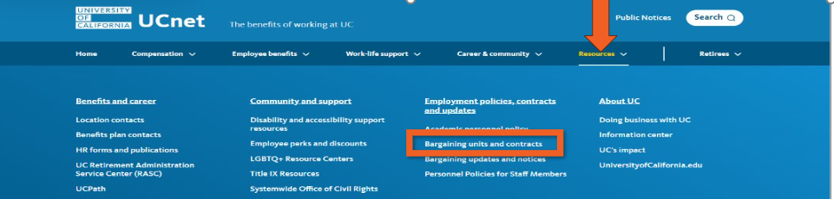
Bargaining Contracts and Personnel Policies
Related to Pay While on Leave

Slide 31
Catastrophic Leave Program
Overview
The UCI Program applies to Campus, Health center and Health Sciences employees and permits salary and benefits continuation for non-represented and eligible represented UCI staff and eligible faculty who have exhausted all paid leave due to catastrophic personal circumstances, including:
their own serious illness or injury
caring for a seriously ill member of the staff or eligible faculty member’s family or household; or
the death of a family member. Subject to the stated eligibility requirements, salary and benefits continuation is achieved through donation of vacation credits from other.
This program is managed by the EEC.

Slide 32
Catastrophic Leave Continued
You’re required to use any leave accrued during the previous pay period(s) prior to use of donated leave hours.
May use donated hours only up to their regular appointment percentage in any pay period.
May receive designated donated (if there are any) and General Pool hours during any unpaid portion of the Basic/Voluntary Short Term Disability Plan waiting period. Eligibility ends when Disability Plan benefits begin.
May receive a maximum of 40 hours, per calendar year, from the General Pool to supplement their leave.
May not receive any hours, or fewer than 40 hours, from the General Pool if there are not sufficient hours in the General Pool.
The extended absence entry in path, must reflect paid for the dates the employee is receiving Catastrophic hours, so the CAT hours can be paid out.
How to Apply:
https://uci.service-now.com/eec?id=sc_cat_item&sys_id=30be30e61bff0c10953b7510cd4bcb4c

Slide 33
Impact to Benefits
While on Leave

Slide 34
Insurance Benefits While on Leave
Paid Leave | Unpaid Leave
All insurance benefits continue as normal deductions from paycheck. | Medical Insurance: monthly premiums billed to home address from UC Path; employees receive UC employer paid contribution when employee’s leave qualifies for PDL, FMLA, CFRA entitlement(s) or on approved short-term disability claim with Lincoln Financial.
 | Dental & Vision Insurance: monthly premiums paid by UC when employee’s leave qualifies for PDL, FMLA, CFRA entitlement(s).
 | Life Insurance: It depends on the plan you’ve elected, please refer to the Leave Without Pay guide.
 | Lincoln Financial Disability: monthly premiums not due while utilizing disability plan.
 | URRP: Employees do not contribute to UC Pension while on unpaid leave.

Slide 35
Timecard Coding
And More!

Slide 36
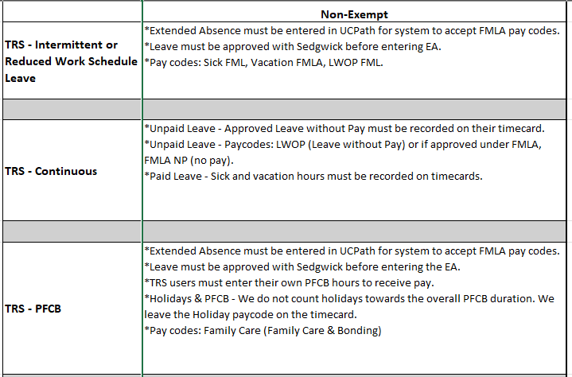
Timecards While on Leave Non-Exempt

Slide 37
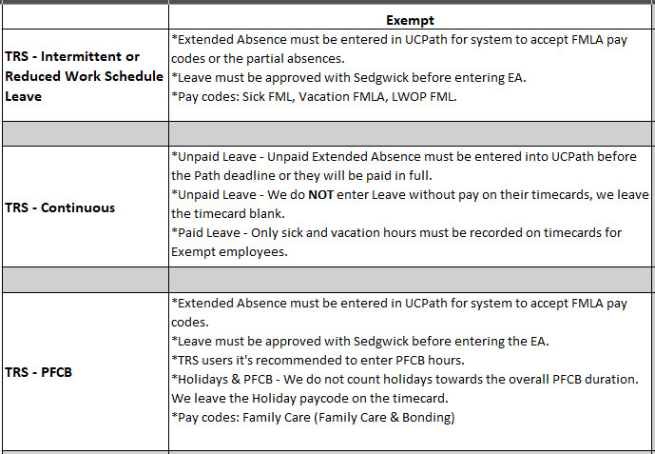
Timecards While on Leave Exempt

Slide 38
Sedgwick – Pending Status
Exempt:
Sedgwick has the leave in a pending status and leave qualifies for PFCB, the Employee can leave their timecard blank, and we can update the timecard later.
  If leave is denied, then we must go back and update timecard from REG to accruals.
Non-Exempt:
Sedgwick has the leave in a pending status, and leave qualifies for PFCB, the Employee can enter regular accruals (non FML codes), and we can update the timecard later.
  If leave is denied, then we will leave the timecard as is – no adjustments needed.

Slide 39
Payroll Issues & Missed Deadline
Some examples of where we can run into payroll issues.
  Exempt Employee on an unpaid leave and the extended absence was entered after deadline.
    This would cause an overpayment and you will need to contact payroll.
  Exempt Employee on an unpaid leave and the extended absence was not updated with their return to work before deadline.
    This would cause the employee to be underpaid and you will need to contact payroll.
  The PFCB extended absence was entered after Path deadline and the PFCB pay was not issued.
    If the employee is exempt contact payroll to update their timecard, but employee's pay would not be impacted.
    If the employee is non-exempt, this would cause an underpayment, therefore you will need to contact payroll to update the timecard and initiate an off-cycle check.

Slide 40
Pay Entries
For all Leave Types

Slide 41
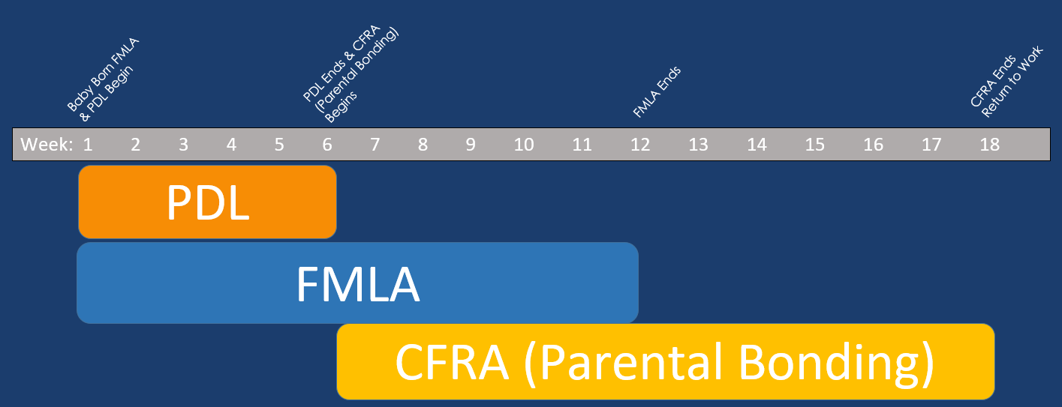
Pregnancy Disability Timeline
How do FMLA, CFRA, and PDL Interact?
Notes:
Go over how PDL and FMLA will run concurrent, but PDL and CFRA would never run concurrent because both state leaves would not run concurrent, only federal and state leaves.

Slide 42
Medical Leave 14 Day Disability Waiting Period
Enter Medical Leave for 14 days, paid using sick and or vacation accruals (per their bargaining contract). For further information around Holiday pay please refer to the appropriate contract or policy.
  This is only when the employee has 10 days of accruals, if less than the paid portion would only reflect their actual accrual balance.
  If the employee does not have enough accruals to satisfy the waiting period, then the employee can request Catastrophic Leave.
Enter the remainder of leave, unpaid and employee will receive disability.

Slide 43
Medical Leave Using 22 Days of Sick Before Disability Starts
Enter Medical Leave using 22 days of sick
Enter the remainder of leave, unpaid and employee will receive disability

Slide 44
Pregnancy Disability Leave With & Without FMLA Eligibility
Enter Pregnancy Leave using 22 days of sick
Enter the remainder of leave, unpaid and employee will receive disability

Slide 45
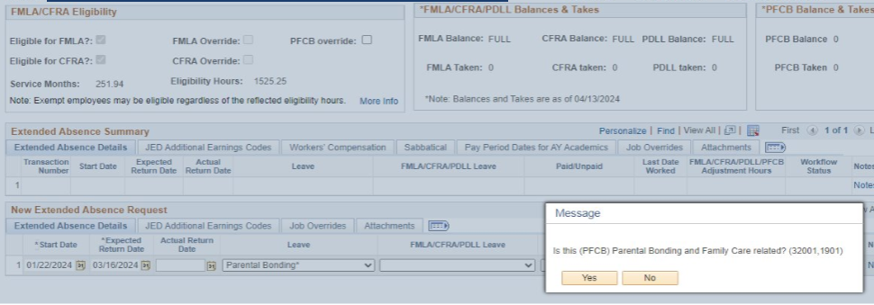
Parental Bonding
Enter Start Date (First day of leave)
Expected Return Date (Day after end date of PFCB)
Leave Type – select Parental Bonding
Select “Yes” when asked if this is (PFCB) related
Pop up message will appear when the leave type is eligible for PFCB pay

Slide 46
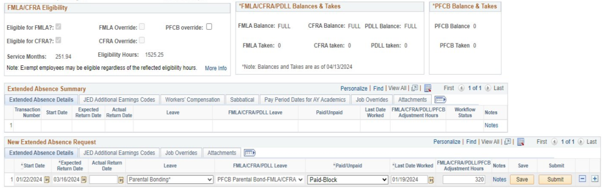
Parental Bonding, Cont.
For the FMLA/CFRA/PDLL Leave section select PFCB Parental Bonding (then choose FMLA/CFRA or FMLA or CFRA
Paid/Unpaid – select Paid-Block
Enter Last Date Worked
Enter your notes for this leave

Slide 47
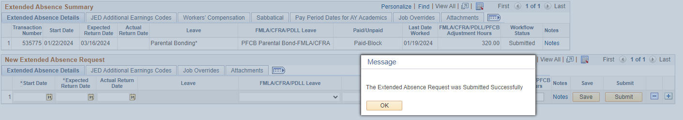
Parental Bonding, Cont.
After clicking the Submit button you will get the pop-up message that your leave entry was submitted successfully. Click OK
Your leave has now been submitted and waiting for approval by your local department HR approver.
After clicking the Submit button you will get the pop-up message that your leave entry was submitted successfully. Click OK
Your leave has now been submitted and waiting for approval by your local department HR approver.

Slide 48
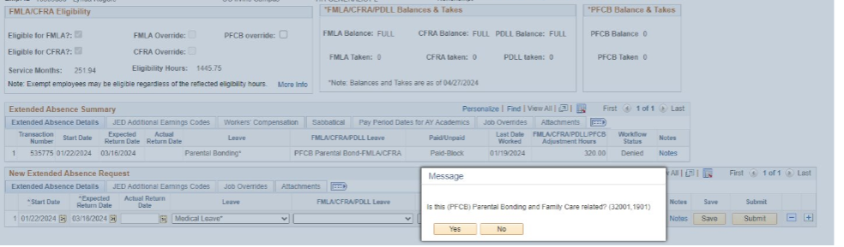
FMLA/CFRA Exhausted Leave
Enter Start Date (First day without FMLA or CFRA entitlement)
Expected Return Date (Day after leave ends)
Leave Type – select Leave type accordingly
Select “No” when asked if this is (PFCB) related
Pop up message will appear when the leave type is eligible for PFCB pay

Slide 49
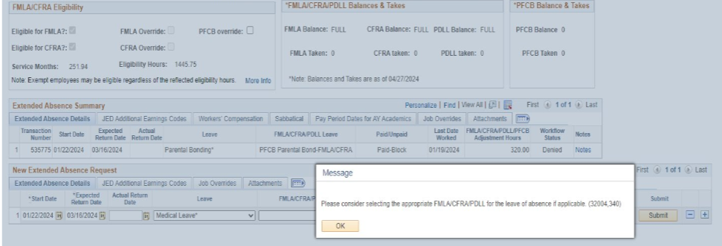
FMLA/CFRA Exhausted Cont.
Click ok.

Slide 50
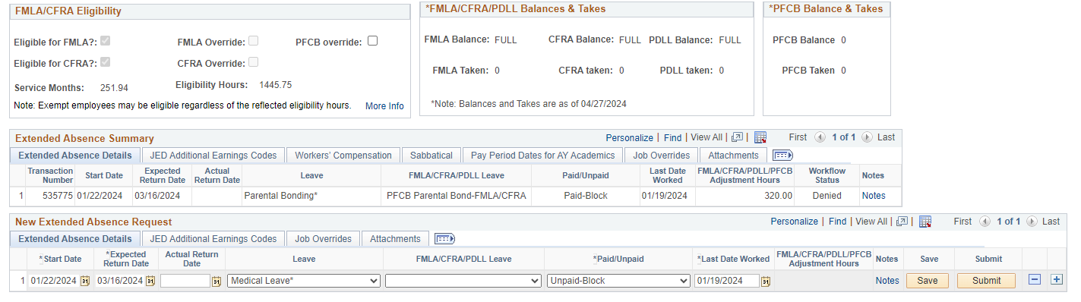
FMLA/CFRA Exhausted Leave Cont.
Since this employee exhausted their FMLA/CFRA entitlements you will not designate it as FMLA/CFRA
Select Paid or Unpaid accordingly
If an employee is on an unpaid unprotected leave, they will be responsible for the entire portion of their benefit premiums (the employee & UC portions)
Enter your notes accordingly Ex: EE out on non-FMLA/non-CFRA Medical Leave. Unpaid Block 1/22/24 – 3/16/24. Expected RTW 3/16/24. Thank you.
Check the leave entry for accuracy then click Submit.
Please note once all leave entitlements have been exhausted the leave will be processed under Disability Management/Accommodation.

Slide 51
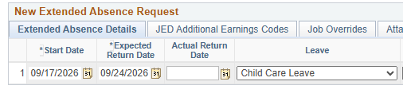
Childcaring Leave
Childcare Leave option in Path is for the new childcaring leave available for most unions: Teamsters, AFSCME, UAW, and UPTE. (has always been in place for CNA)
  Teamsters effective 07/02/2026, AFSCME effective 05/23/2026, UAW effective 03/20/2026, UPTE efective11/07/2025.
Childcare Leave begins when the maternity leave ends.
Duration: 26 weeks or 6 months.
Can run concurrent with FMLA and CFRA.
If they're not eligible for FMLA or CFRA, they can still be eligible for childcaring leave.
If childcaring leave is not running with CFRA or FMLA and the leave is unpaid, then employee will charged for full benefit premiums.
Once CFRA exhausts, employee must continue to remain out under childcaring leave if they want additional time. If they return to work prior to childcaring leave exhaust, then the employee can not go back out on leave to use the remaining amount. However while CFRA is running with childcaring leave, then we follow the CFRA rules of 2 instances over 2 weeks and 2 instances under 2 weeks. Provide example.

Slide 52
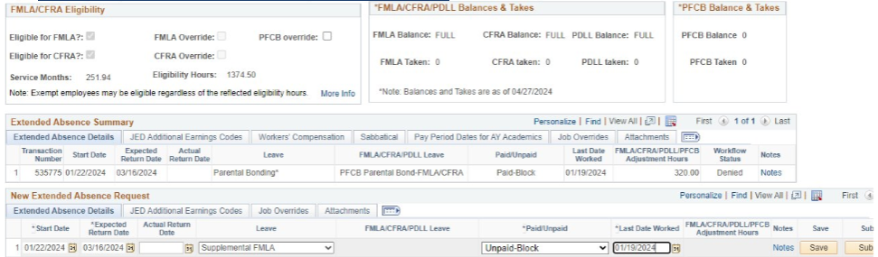
Supplemental FMLA (non-represented)
Enter Start Date (First day of leave or First day without FMLA or CFRA entitlement.)
Expected Return Date (Day after end date)
Leave Type – select Supplemental FMLA
Select Paid/Unpaid option
Enter Last Day Worked
Check the leave entry for accuracy then click Save and then Submit
Only for Non-Represented employees

Slide 53
Editing Extended Absences
When the extended absence entry is in approval processing status, meaning it is sitting with Path to approve therefore the option to edit the transaction is not available. You can submit a ticket to Path and request them to push it back. Or depending on the deadline and type of extended absence you can wait for Path to process the approval and then update.
Please note around pushed back extended absences in path. Once these are updated and re-submitted, the local approver must go under Administer Extended Absences, search for the extended absence to approve.
  The extended absence will not show up in your worklist, so you must reach out to your approver, ask them to search for it and approve it.

Slide 54
Accommodations
Also known as Disability Management

Slide 55
RECOGNIZING LEAVE & Accommodation Needs
Employee’s may not specifically ask for a leave of absence or an accommodation, here are some ways to recognize there is a need:
This is not always straightforward
Isn’t always “I hurt my back and can’t lift”.
Challenges can be physical or mental.
Can be seen as stress, a need to step away from work frequently, need more time to complete tasks, loss of focus in their environment, crying at work, sleeping at work, etc.
Can be excessive absences or frequent tardies.
Can be an employee using medical reasoning as an explanation for absences or performance issues (medication makes it hard to focus, needing extra breaks due to illness, etc.).
Keep an ear out for anything that might be putting us on notice of a disability, or something that has put us on notice in the past.
Advise the employee that if they believe they have a disability that needs accommodation or leave of absence, they should reach out to Sedgwick for assistance and to start the process. Discussions with the employee should be documented.

Slide 56
CAN & CANNOT’S
When making a request, medical documentation only needs to indicate that an individual has a disability/serious health condition which necessitates a reasonable accommodation or leave of absence. Specific diagnosis information is not required.
Cannot:
Ask the individual or their medical provider to specify the medical diagnosis/condition.
Ask the reason why an accommodation or leave is needed.
Can:
You can ask if the employee needs an accommodation or leave of absence.
Provide the individual with the correct information to start the accommodation or leave process.
Ask for estimated dates in which the accommodation or leave may be needed.
Ask if there is anything you can do to provide support.
Check in periodically and discuss return to work plans with the employee.

Slide 57
INTERACTIVE PROCESS
Interactive Process refers to the process in which employees, supervisors, and their departments determine whether a reasonable accommodation can be made to an employee. This is a legal obligation that applies to both workers’ compensation and non-occupational related injuries or illnesses.
Once we are aware of an accommodation need, we are required to engage in the interactive process to find out if there are reasonable accommodations that will allow them to be successful.
The Disability Management Specialist will help guide you through this process.

Slide 58


INTERACTIVE PROCESS
Notified of accommodation request
Monitor the accommodation. Document entire process
Gather information, identify essential job functions
Monitor the accommodation. Document entire process
Effective IP
Engage with employee and explore accommodation options
Implement the accommodation
Choose a Reasonable Accommodation

Slide 59
Resources
And More!

Slide 60
Resources/Websites
https://hr.uci.edu/
https://hr.uci.edu/partnership/LAW/quick-request.php
https://hr.uci.edu/partnership/leaves/
https://hr.uci.edu/partnership/LAW/leaveadmin/
https://hr.uci.edu/partnership/LAW/workers-compensation.php
Coming in 2026 New Accommodation Website!

Slide 61
Resources & Trainings
Your Guide to UC Disability Benefits
https://ucnet.universityofcalifornia.edu/forms/pdf/your-guide-to-uc-disability-benefits-fact-sheet.pdf
Disability Information on UC Net
https://ucnet.universityofcalifornia.edu/forms/pdf/your-guide-to-uc-disability-benefits-fact-sheet.pdf
Upcoming Trainings – please register under UCLC
Quarterly Disability Management & The Interactive Process
Bi-Annual - mySedgwick Training
Every Other Month - Expecting Parents Workshop
Bi-Annual – Leaves & UCPath Entries for De-Centralized Campus (this training)
Bi-Annual - Managing Staff Leaves w/ Sedgwick training.
  Please be sure to register for the appropriate training, i.e. Campus/COHS or Medical Center.

Slide 62
Questions

